Slide 1
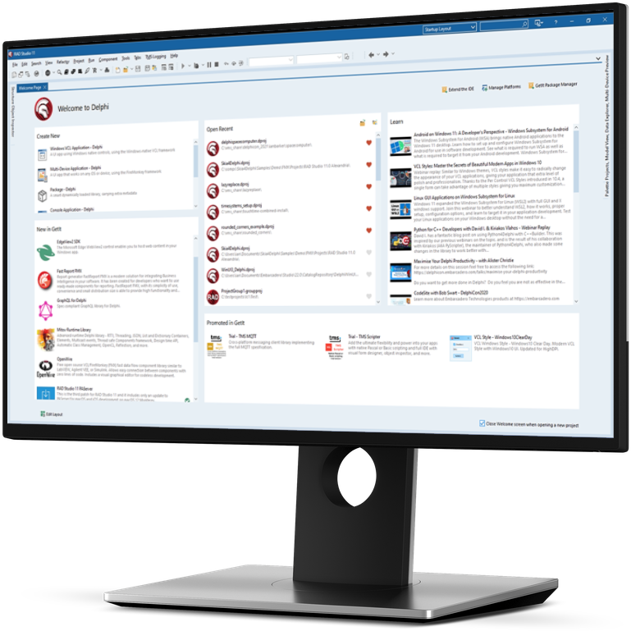


Picking the Best UI Framework for Windows 11 Development
Ian Barker
Embarcadero Delphi MVP
ian.barker@gmail.com
@punctuation about.me/IanBarker
Slides, link & replay: https://tinyurl.com/win11bestui

Slide 2

Agenda
The challenges of Windows 11
Doing it the hard Microsoft way
Doing it the easy way
Adding the wow! factor
Q&A

Slide 3
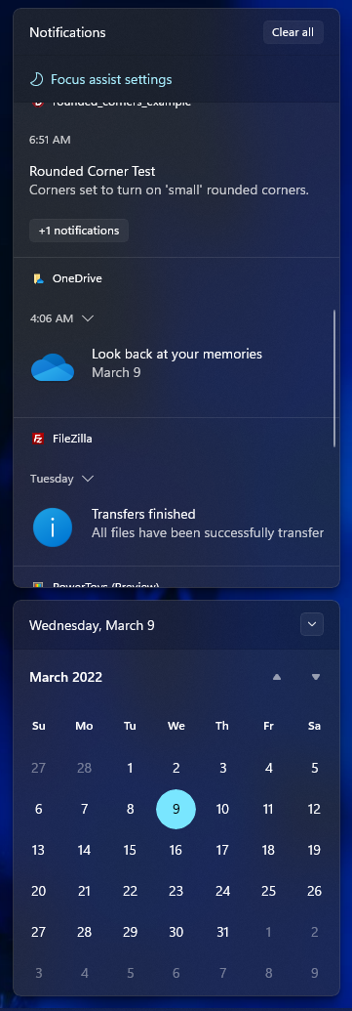
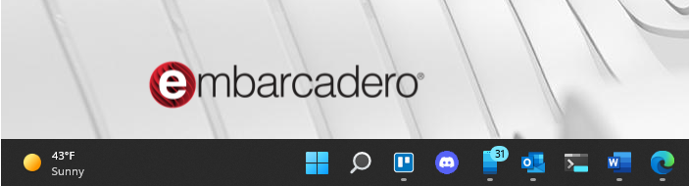
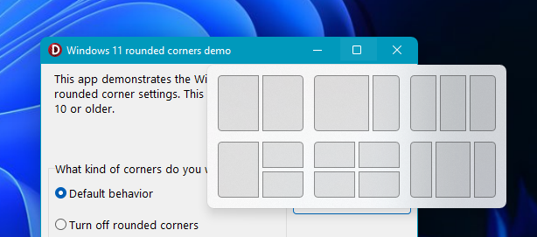
The challenges of Windows 11
The toolbar became centered
New types of window behavior
New UI standards

Slide 4
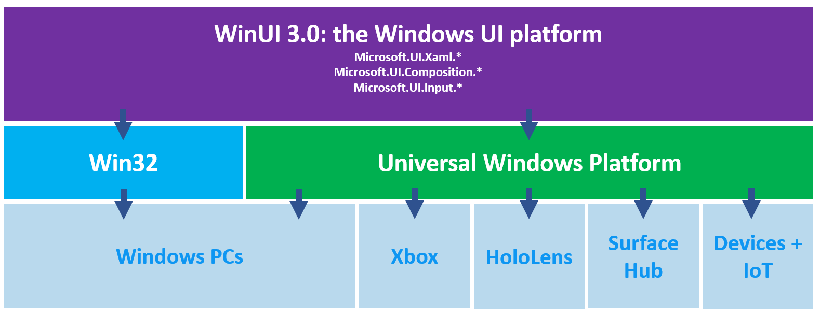
Doing it the hard Microsoft way
Microsoft have the Win UI3 project
https://docs.microsoft.com/en-us/windows/apps/winui/winui3/
Notes:
The Windows App SDK was previously known as Project Reunion. WinUI 3 is the native UI platform component that ships with the Windows App SDK (completely decoupled from Windows 10 and later SDKs). The Windows App SDK provides a unified set of APIs and tools that can be used to create production desktop apps that target Windows 10 and later, and can be published to the Microsoft Store.

Slide 5
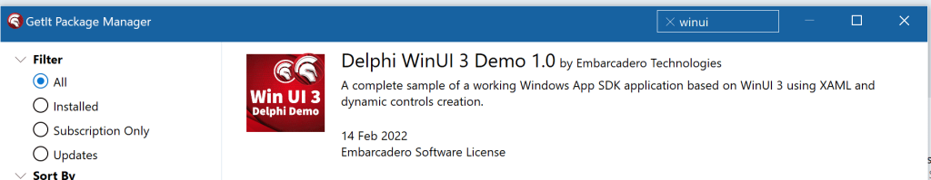
Doing it the hard Microsoft way
Marco has a demo of using UI3 with Delphi
https://blogs.embarcadero.com/delphi-winui-3-demo/
Notes:
Declarative UI. Lots of dependencies to install. DLL/versioning. Very fiddly and unclear to set up right now - this will improve once things at Microsoft settle down a little.

Slide 6
Doing it the easy way
VCL or FireMonkey FMX
FireMonkey if you’re going to go cross-platform
VCL for an authentic, close-to-the-metal experience
Delphi 11 Alexandria has the most optimum experience
New Delphi styles added specifically for Windows 11

Slide 7
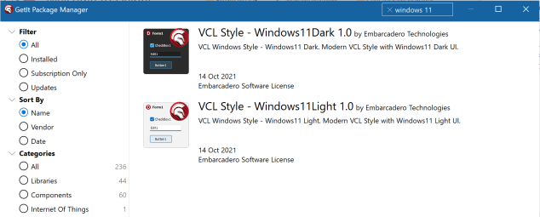
Doing it the easy way
VCL specific for Windows 11
Styles
https://blogs.embarcadero.com/more-vcl-support-for-windows-11/

Slide 8
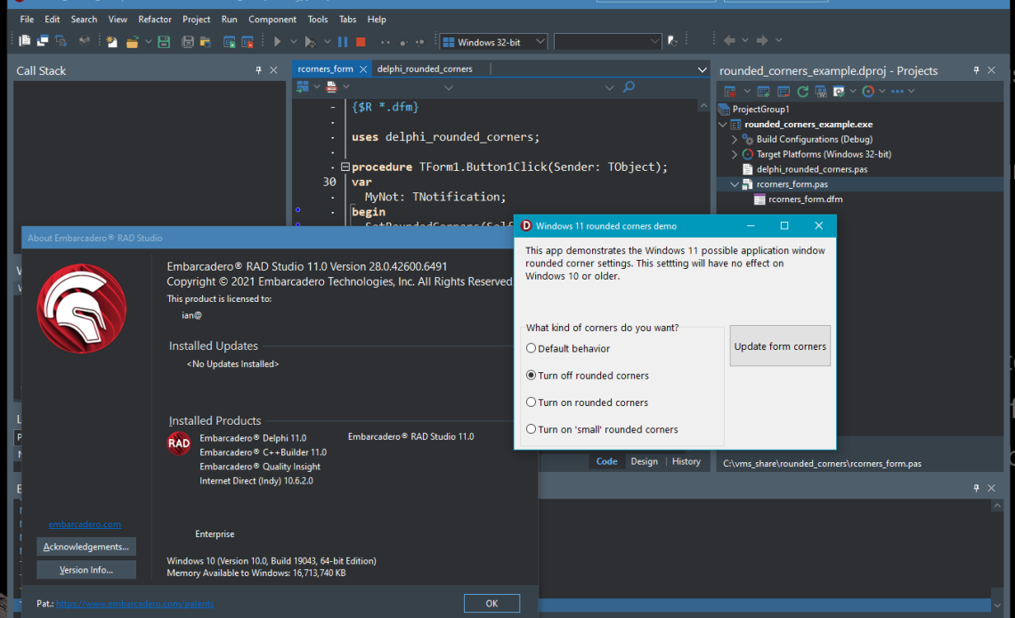
Doing it the easy way
VCL Specific Posts
Controlling Rounded corners
https://blogs.embarcadero.com/how-to-control-windows-11-rounded-corners-in-your-app/

Slide 9
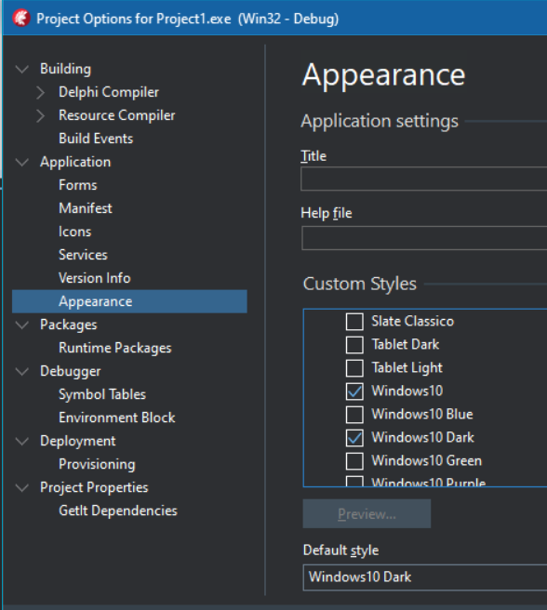
Doing it the easy way
VCL Specific Posts
Supporting dark mode
https://blogs.embarcadero.com/modernize-your-app-are-you-handling-windows-themes-correctly/

Slide 10
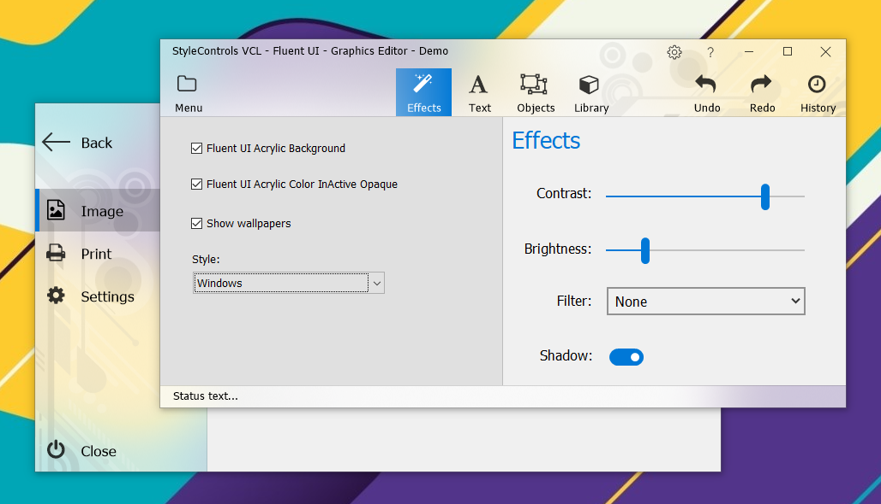
Adding the wow! factor
Fluent UI effects
Really adds the x-factor
https://www.almdev.com/prods/stylecontrols/stylecontrols.html

Slide 11

Adding the wow! factor
Turbocharge your FireMonkey and VCL apps
https://www.skia4delphi.org
Notes:
Support SVG, WebP, Lottie Animations, RTL text in FireMonkey. One customer complained that they were only able to get 1000 fps for a FULL SCREEN animation - lol (100fps without Skia4Delphi). Spirit of Delphi 2021 winners.

Slide 12

DelphiCon 2021 - Catch the replays
delphicon.embarcadero.com/replays/

Slide 13
More information
Start a RAD Studio trial embarcadero.com/products/rad-studio/start-for-free
Get Community Edition embarcadero.com/products/delphi/starter
Upgrade Today! embarcadero.com/app-development-tools-store/rad-studio
See special offers embarcadero.com/radoffer
Subscribe on YouTube youtube.com/c/EmbarcaderoTechnologies
Follow us on Twitter twitter.com/embarcaderotech
Like us on Facebook facebook.com/embarcaderotech
Follow us on LinkedIn linkedin.com/company/embarcadero-technologies
Read our blog blogs.embarcadero.com

Slide 14
https://tinyurl.com/win11bestui
Picking the Best UI Framework for Windows 11 Development
Ian Barker
Embarcadero Delphi MVP
ian.barker@gmail.com
@punctuation about.me/IanBarker
Slides, link & replay: https://tinyurl.com/win11bestui

